Slide 1
QUAID-E-AWAM UNIVERSITY OF ENGINEERING, SCIENCE & TECHNOLOGY NAWABSHAH, SINDH, PAKISTAN
Assignment
On
VISUAL PROGRAMMING(VP)
UML DIAGRAMS & DATA TABLE
Submitted to: SIR ZEESHAN RASOOL
Submitted by: 20IT06

Slide 2
Cafe management system
UML DIAGRAMS
&
DATA TABLES

Slide 3
Cafe management system
USE-CASE
DIAGRAM

Slide 4
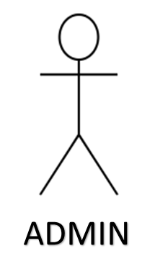

Library management system
Login
Place Order
Add Items
Update Item
Remove Item
Logout

Slide 5
Cafe management system
ACTIVITY
DIAGRAM

Slide 6
LOGIN
NEW USER
REGISTER
NO
YES
ATHENTICATION
INVALID
CHECK
VALID
GUEST

Slide 7
PLACE ORDER
PLACE ORDER
ADD ITEMS
CANCEL ORDER
UPDATE ITEMS
REMOVE ITEMS
LOGOUT

Slide 8
Cafe management system
CLASS
DIAGRAM

Slide 9
LOGIN FORM
- USER TYPE : CHAR
- USERNAME: CHAR
- PASSWORD: CHAR
+ LOGIN ();
+ LOGOUT ();
GUEST
DASHBOARD
PLACE ORDER
- NAME: CHAR
- TITLE: CHAR
+ ISSUE DATE: DATE
- ROLLNO: CHAR
- NAME: CHAR
+RETURN DATE: DATE
- MOB NO : INT
- AUTHER: CHAR
+CATAGERY:
- BRANCH: CHAR
+ITEMS:
+ PLACE ORDER();
+ PLACE ORDER ();
+ AVAIBLE BOOKS ();
+ CANCEL ORDER();
+ VERIFYDETAILS ();
+ CANCEL ORDER ();

Slide 10
USER
ADD ITEMS
REMOVE ITEMS
- NAME: CHAR
- NAME: CHAR
- CATEGORY: CHAR
- CATEGORY: CHAR
- ITEM: CHAR
- CANCEL: CHAR
+ ADD ITEM();
+ REMOVE ITEM();
+ CATAGERY();
+ UPDATE ITEM();

Slide 11
Cafe management system
DATA-BASE
TABLE

Slide 12
